Slide 1
Aggie Bucket List
Kevin Lei

Slide 2
Aggie Intro

Slide 3
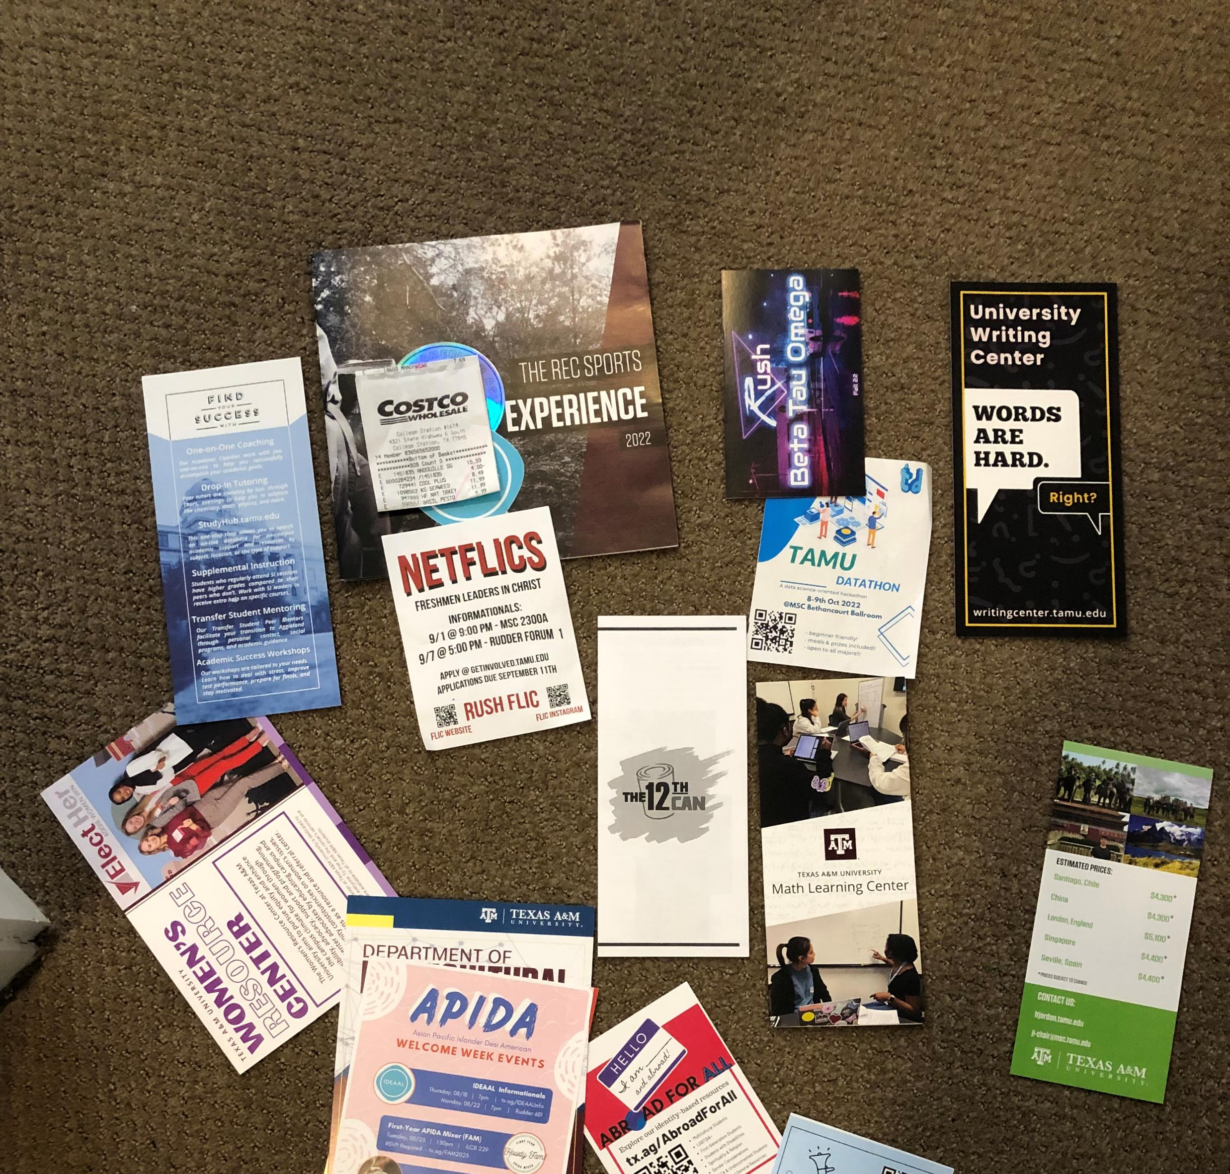
MSC Open House

Slide 4
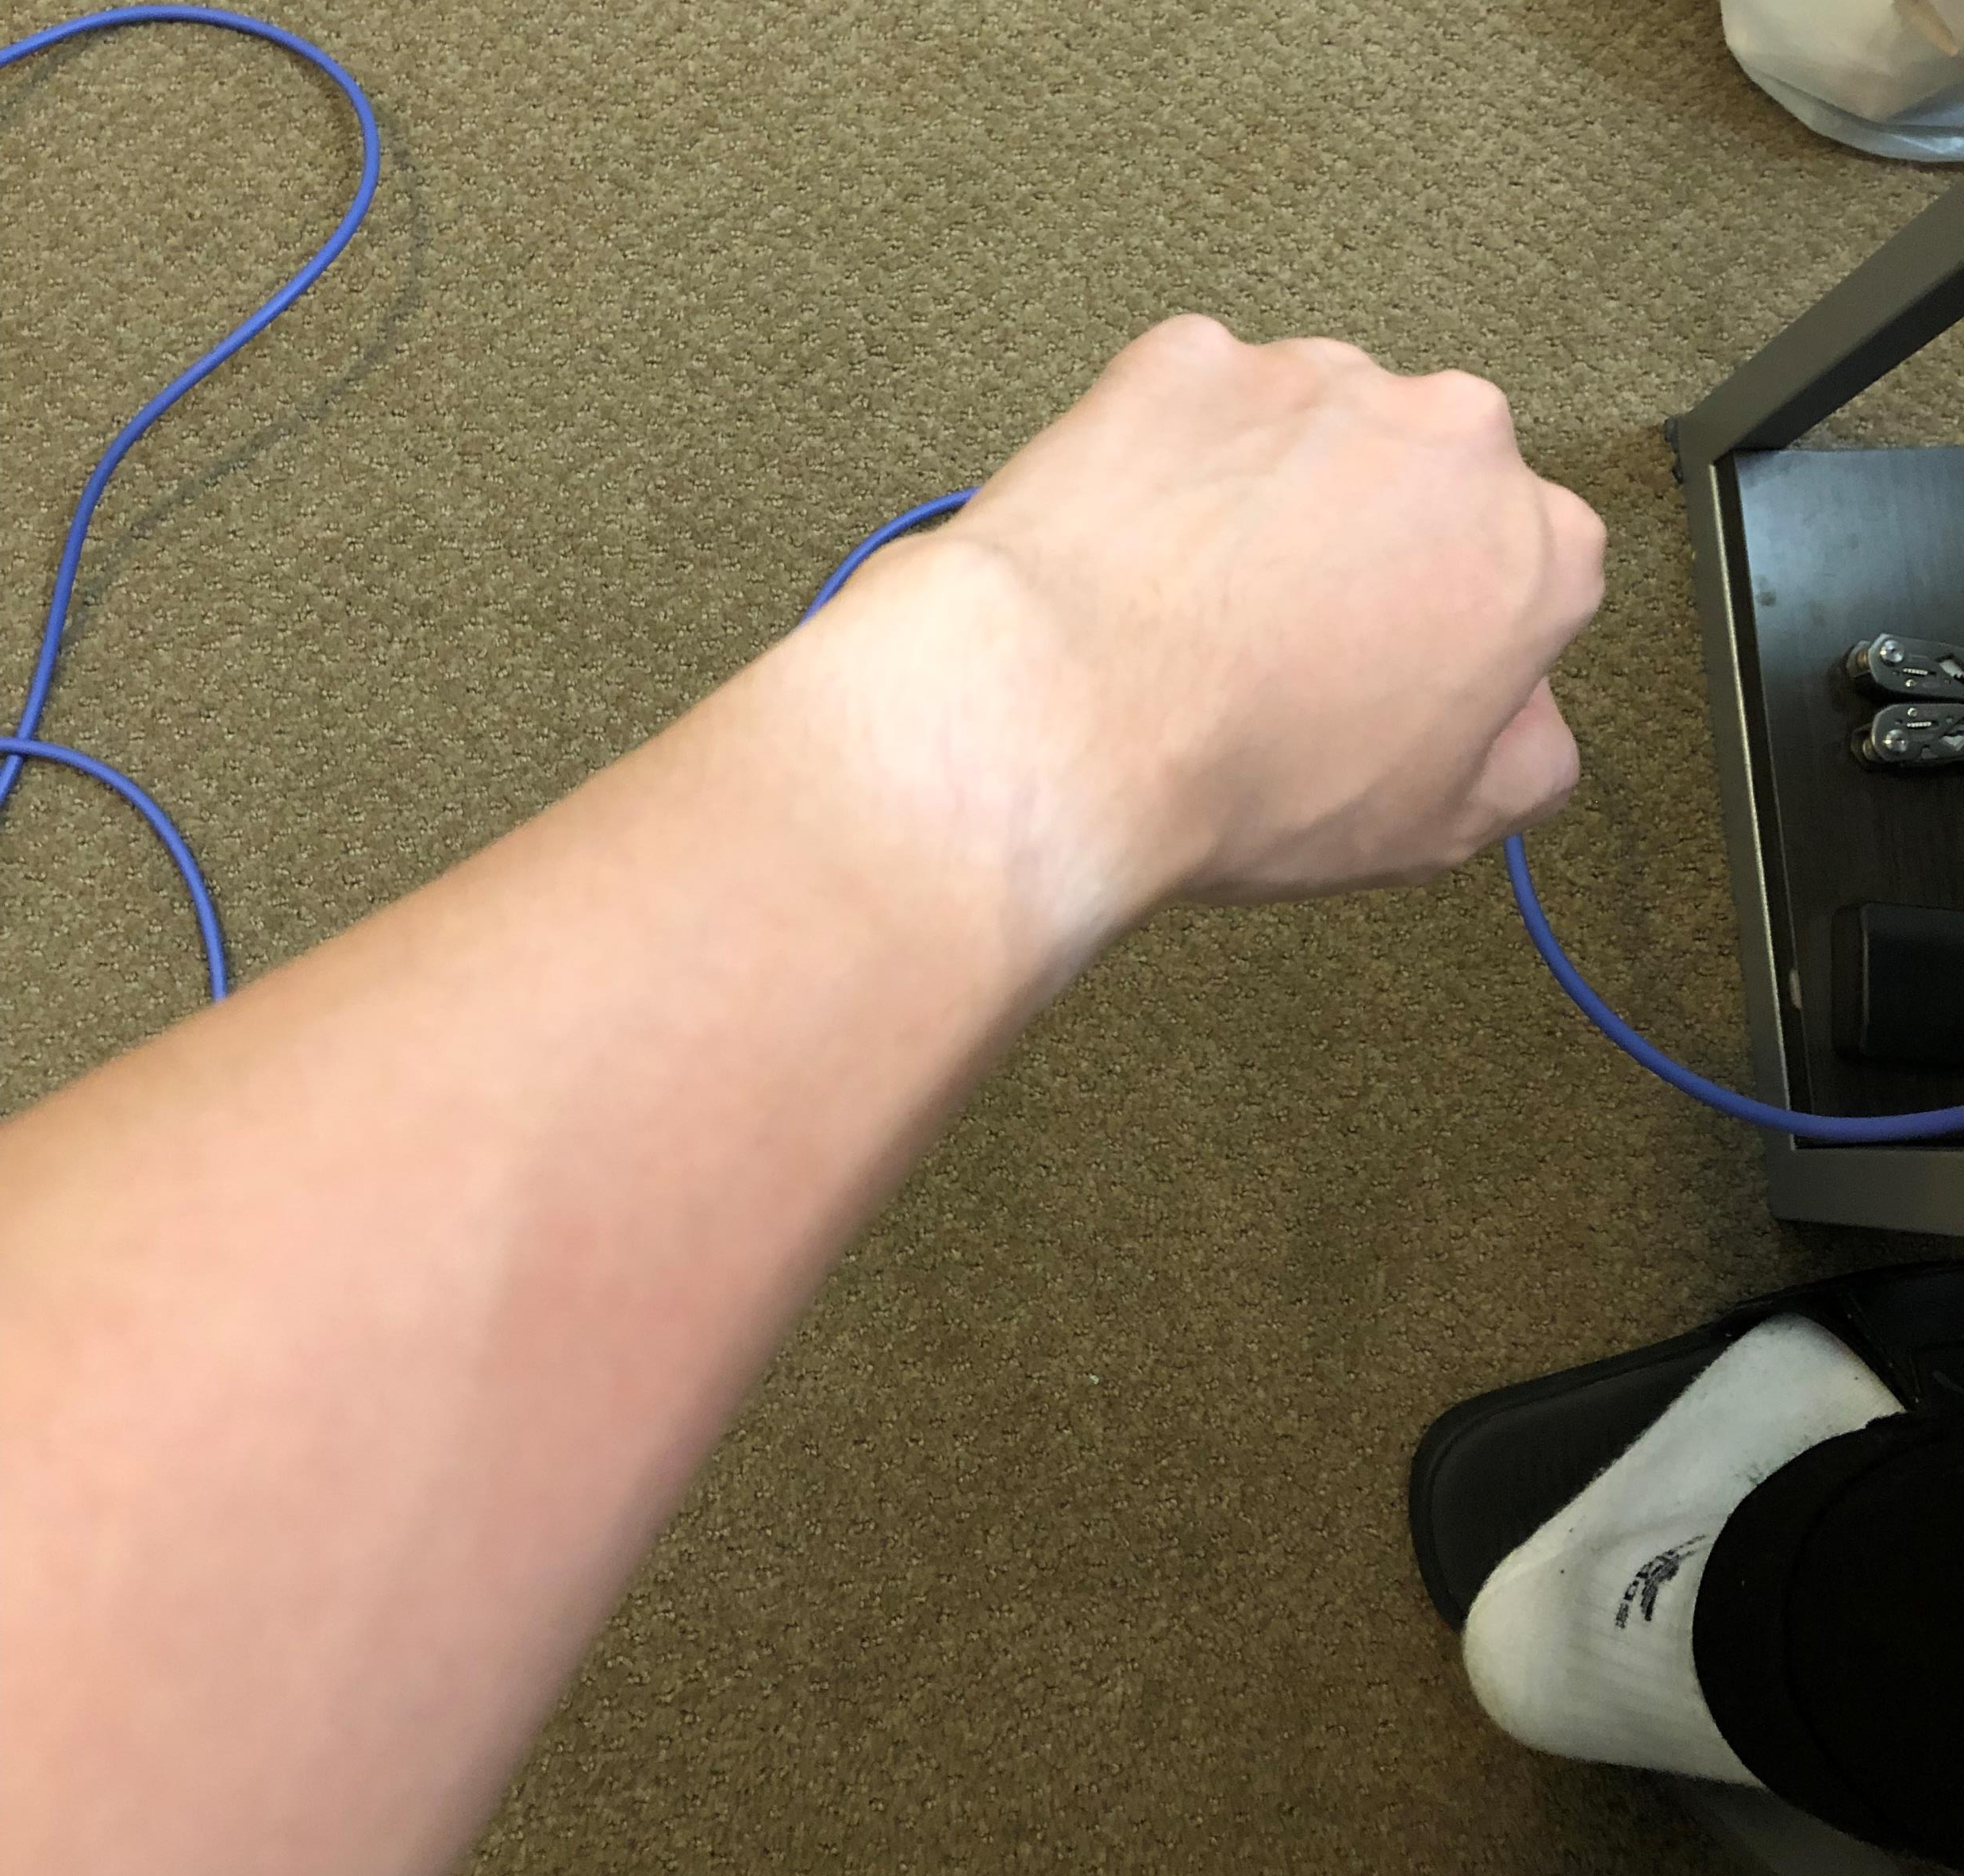
Aggie Park

